Slide 1

Ingredients to recipe generator
Siddharth kumar-23107044
Sarvesh Deve-23107021
Arjun Talekar-23107005
Yash Patil-23107007
Project Guide
Ms Veena Trivedi

Slide 2
1. Introduction
• The “Ingredients to Recipe Generator” is to simplify meal preparation by transforming a list of available ingredients into delicious recipes.
• With the rising demand for quick and easy solutions to meal planning, this bridges the gap between culinary creativity and convenience.
Problem Identified : In today’s fast-paced world, individuals often struggle with meal planning and preparation due to time constraints, dietary preferences, and the challenge of using available ingredients efficiently.

Slide 3
Solution: Flavour Fusion provides an user-friendly platform that transforms the way individuals discover and prepare meals by addressing these challenges. The solution utilizes smart algorithms to generate personalized recipe suggestions based on the ingredients users already have, thus eliminating the need for lengthy recipe searches

Slide 4
2. Objectives
To develop a method that can suggest recipes based on the input ingredients provided by the user.
To create an interactive and intuitive interface for users to input ingredients receive recipes.
To accommodate an expanding database of recipes and user inputs efficiently.
To effortlessly manage the users using our platform

Slide 5
3. Scope
Recipe Discovery: The platform’s adaptable framework provides a robust system for generating diverse recipe options, helping users explore new meal ideas
User Experience: The versatile and intuitive features ensure a smooth and engaging experience, allowing users to filter recipes based on meal type, preparation time, and difficulty level.
Sustainability and Accessibility: The scalable framework promotes resourceful cooking by suggesting recipes that minimize food wastage while catering to individuals with various dietary needs and skill levels.
Target Audience: The platform provides a valuable tool for students, working professionals, and home cooks looking for quick, budget-friendly, and creative meal solutions.

Slide 6
4. Feature /Functionality
1.Categorized Recipes: Sort recipes by categories such as Starters ,main courses , desserts , etc.
2. Recipe Generation: It provides recipes based on the ingredients provided by the user.
3. Search and Filter: Enables users to search for recipes by specific cuisine, cooking method, or available appliances.
4. Food Waste Reduction: Encourages efficient use of available ingredients, helping minimize food waste.

Slide 7
5. Outcome of Project
User Can log in
User can search for any dish by its name or by its ingredients
User can also choose categories like starters , main courses , desserts , etc
After user search for any specific dish it will give step by step instruction on how to cook the dish

Slide 8
6. Technology Stack
Python with Tkinter – Python, along with the Tkinter library, is used to develop the user-friendly graphical interface for Flavour Fusion. It enables the creation of a simple yet effective UI for the user.
2. MySQL (Version 8.0.1) – MySQL serves as the database management system for Flavour Fusion, handling user profiles, recipe data, ratings, and ingredient records. Its relational structure ensures efficient data retrieval, security, and integrity, allowing users to access personalized recipe recommendations seamlessly.

Slide 9
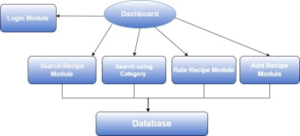
7. Block Diagram

Slide 10
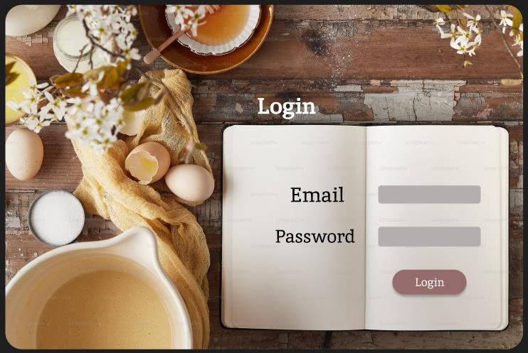
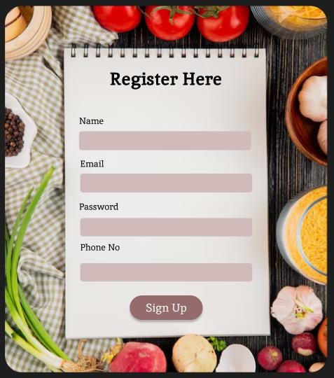
8. Results

Slide 11
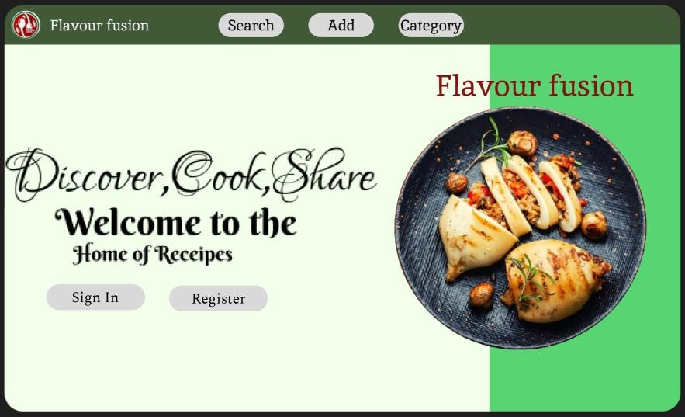
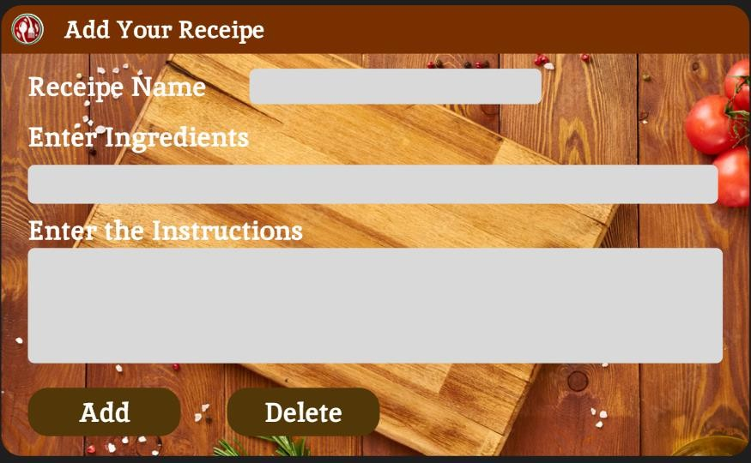

Slide 12
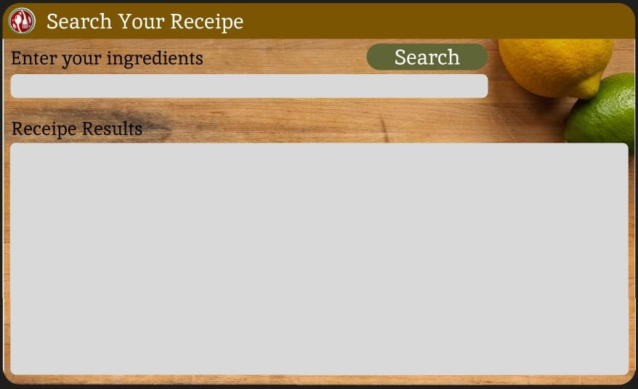
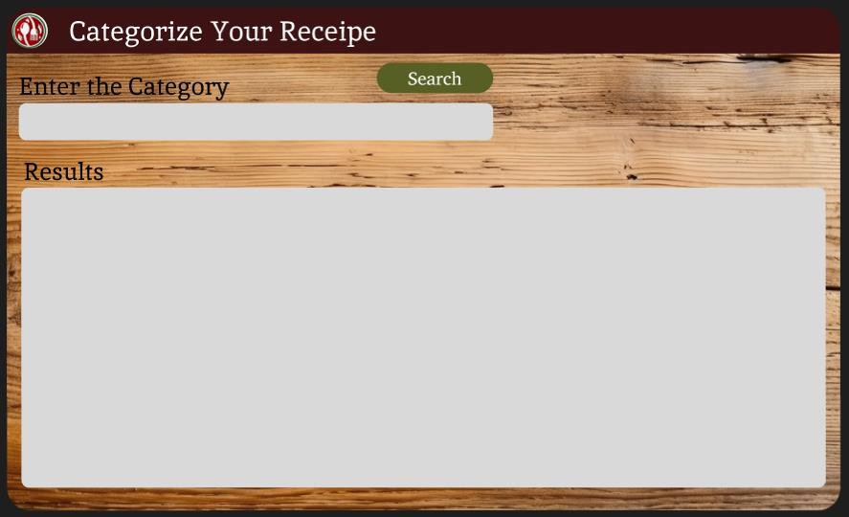

Slide 13
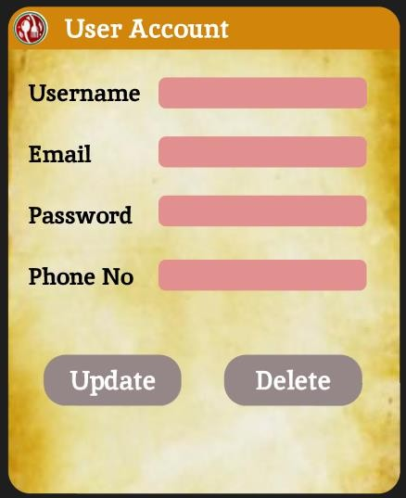
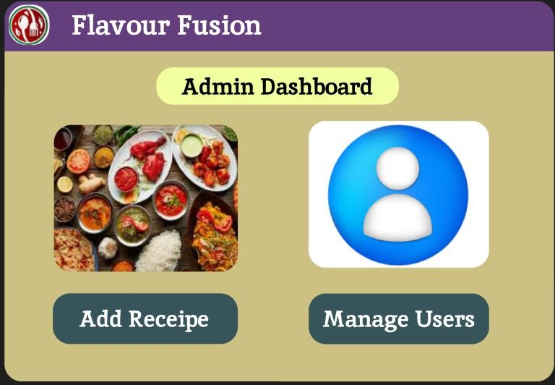

Slide 14
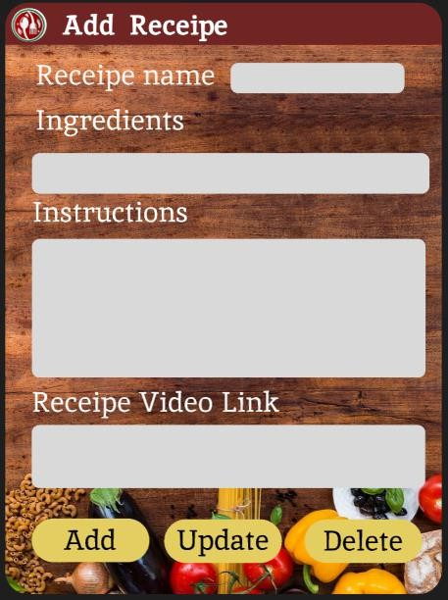
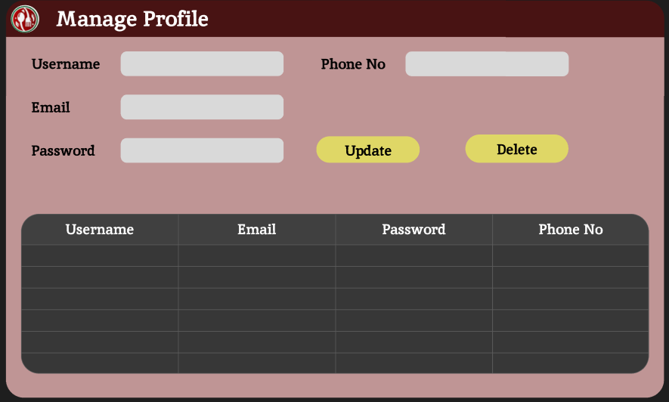

Slide 15
Thank You...!!

